Slide 1
Two-speed OF
By :
Aditi Pradeep
University of British Columbia

Slide 2
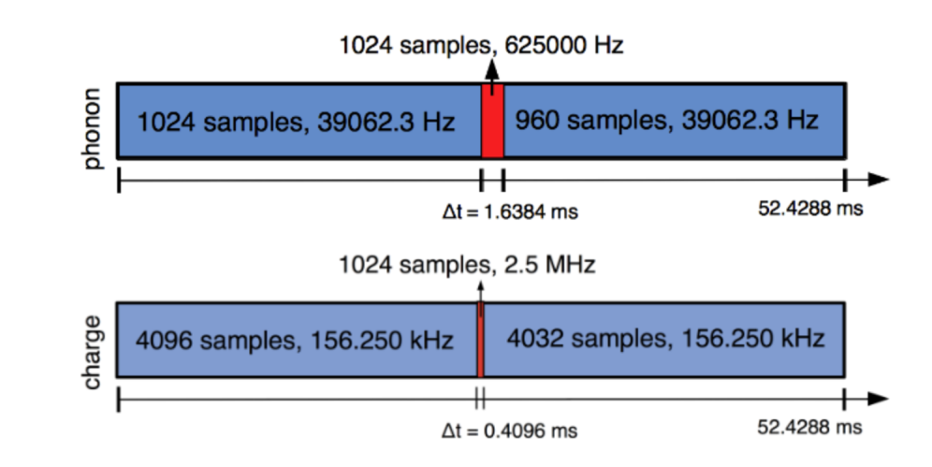
Hybrid readout scheme
Phonon trace
Charge trace

Slide 3
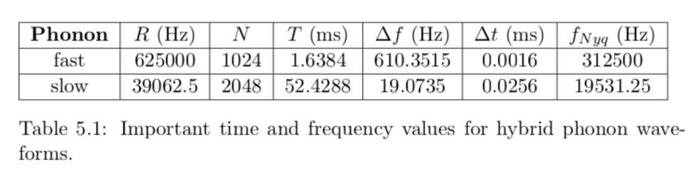
Correlation in hybrid readout
n | 1 | 2 | ... | 32... | ...64... | ...96... | ..128.. | ... | 1024
(Hz) | 19.1 | 38.2 | ... | 610.4 | 1220.7 | 1831.1 | 2441.4 | ... | 19531.25
n | 1 | 2 | 3 | 4 | ...32... | ...512
(Hz) | 610.4 | 1220.7 | 1831.1 | 2441.4 | 19531.25 | 312500
Downsampling results in loss of information beyond f_(slow) > 19.531KHz for the slow region, resulting in those frequencies getting aliased into f_(slow)<f_(Nyq).

Slide 4
Correlation in hybrid readout
In the optimal filtering process, this is reflected by a change in the covariance matrix - from previously being diagonal to now turning non-diagonal.
The current OF being used is not equipped to handle this change.

Slide 5
Possible solutions
Hybrid optimal filter- Computationally intensive
Apply anti-aliasing before downsampling - Work ongoing
Two-speed optimal filter

Slide 6
Two-speed optimal filter
Adaptation of existing OF
Handles correlations effectively
Approach: Deals with slow and fast sampled regions separately and combines the results using appropriate covariance matrix.

Slide 7
Method
Take a hybrid trace
Extract fast region
Uniformly downsample signal
Apply OF
Amplitude, A2
Time delay, t0
Move template to right position using t0
Apply OF
Combine using Covariance matrix
Time delay=0
Amplitude, A1
COMBINED AMPLITUDE, A0

Slide 8
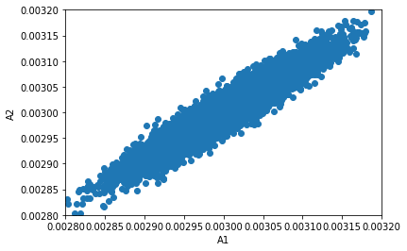
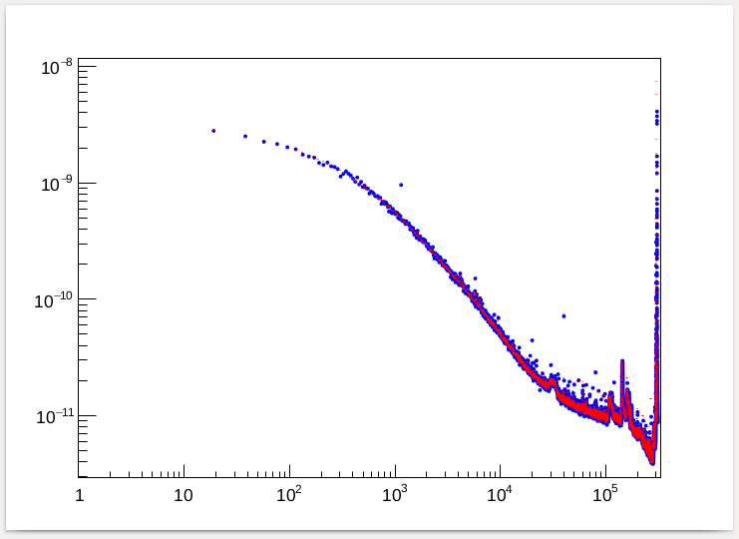
Finding the covariance matrix
Assume stationary noise.
Simulate 10,000 hybrid traces with same template and different noise generated from PD2 noise PSD.
Apply modified OF on all 10,000 traces.
Estimate covariance matrix between slow fit A1 and fast fit A2.
Blue: Generated PSD
Red: PD2 PSD

Slide 9
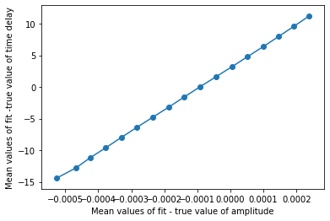
Importance of getting the time offset
The worse the time delay estimates are, the worse the amplitude estimates.

Slide 10
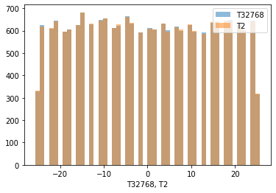
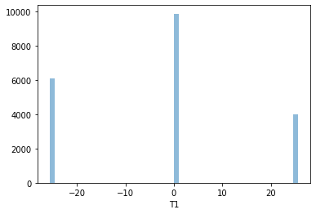
Shifting the template for slow fit
Time delay fits for delay drawn uniformly in the interval [-25.6,25.6]microsec.
Fits from full trace and fast region
Fits from uniformly downsampled trace

Slide 11
Combining the fit results
Minimizing this:
where,

Slide 12
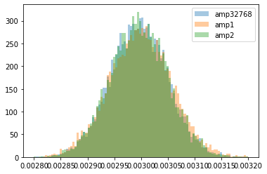
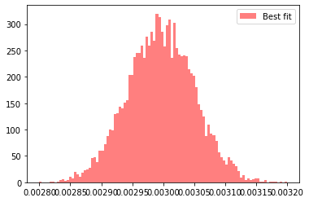
Results
Errors on amplitude estimates:
Fast region fit, A2 : 1.81-1.84%
Uniformly downsampled fit, A1 : 1.9-1.94%
Full trace fit, A32768 : 1.77-1.81%
Combined fit, A0: 1.79-1.82%
Combined fit result is nearly as good as the result from the full non-downsampled trace.

Slide 13
Future prospects
Implementing the two-speed NxM filter.

